Slide 1



Prelims SAE Baja 2024
TEAM TORQUE
Everyone starts the race, but a few finish it.
Old team Team ID: 23100
Car no. : 81
Endurance score: - Total score: Awards: -
Team ID : 24172
College name: Vasavi College Of Engineering.

Slide 2
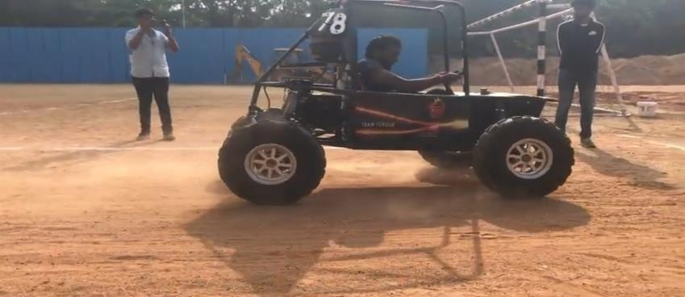
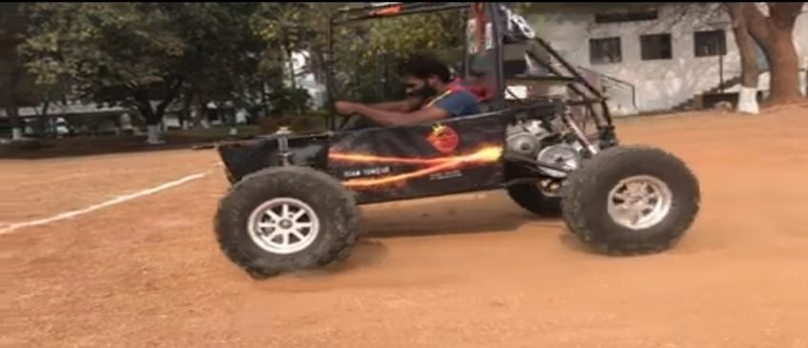
² Lessons learnt
Roll cage:
By eliminating excessive triangulation, the weight of the buggy is reduced.
Improved strength to weight ratio by 80%
More clearances are given in the chassis
Vehicle's Performance in Main Event
Cleared Technical inspection.
Failed to attend the brake test.
Breakdowns/Failures-:
Scrutinizing of the vehicle was done
During the testing, we figured out few failures, which
were :
Camber in the rear right wheel
Due to manufacturing errors, there was quite an abrasion
in the machining components.
Improvements:
Better clamp lengths for suspension
Proper validation, quality, and testing should be done after machining
Reduce the manufacturing errors by preparing more jigs and fixtures
More time is required for testing the vehicle
Lighter knuckles and hubs.
Testing facility:
Miscellaneous:
1.Clearance issues with transmission components.
2.Better casings for the transmission and braking components

Slide 3
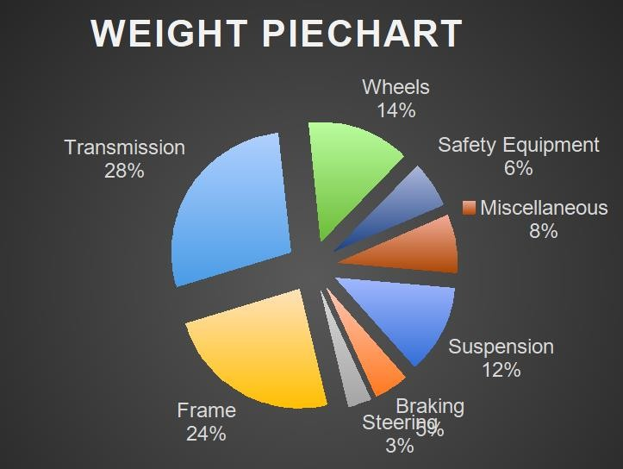
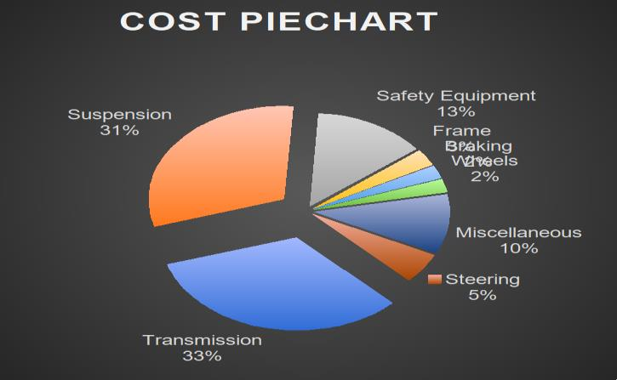
Old vs new
3
Parameter | Old | New
wheelbase | 1320 | 1320
Frame | 26 Kg | 28Kg
Max Velocity | 56Kmph | 57.23Kmph
Suspension | Front : Double wishbone Rear: semi trailing arm | Front: double wishbone Rear: H arm with upper link.
Steering Drive | Centre | Centre
Kerb Weight | 157 kg | 150 kg
Gradeability | 60% | 65%
Steering Ratio type | 4.33:1 | 4.33:1
Brake Calipers | 2 Floating&1 fixed | 2 Floating&1 fixed
Max Acc | 6.01m/s2 | 6.61 m/sec2
Stopping Dist. | 4.5m | 3.04m
Weight transfer | 38.97% | 28.59%
Turing radius | 1.4m | 1.4m
Drive | RWD | 4WD
Max gear ratio | 12:1 | Rear : 12:1 Front:12.75:1
Max torque | 524N-m | 544N-m
Overall length | 1920mm | 1893mm
Overall width | 1270mm | 1188.72mm
Overall cost | 3,89,000/- | 4,10,000/-
Cost and weight optimization:
system | Individual components | Cost(Rs) | Weight(Kg)
Suspension | Shock Absorbers+ Hub+ A arms+ H- frame & link+ Knuckles+ Uprights | 102+8+0.5+0.6+5+6= 1,22,100 | 6+4+2.4+3+1.7+1.5= 17.6
braking | Disc Plates+ Brake pedal+ Brake calipers + Brake hose+ Master cylinder | 2+0.3+4.5+0.9+1= 8,700 | 2+0.5+2.25+1+0.5=6. 25
steering | Wheel + R&P + Column + Joints + Tie rods + Hubs | 0.5+10+ 0.5+ 1.5+ 1.5+1.8= 15,800 | 0.4+1.2+1.5+1+0.5+0. 4= 5
frame | Tubes+ Padding+ Clamps+ Firewall+ Welds+ Paneling + Aesthetics | 25+1+1.5+0.5+1+0.45+ 0.5=29,950 | 15 +1+3+ 1.5+2+0.8+0.2= 23.5
transmission | Engine+ CVT+ Shafts+ casing+ rear Gear box+ front gearbox+ propellor shaft | 87+45+30+0.8+40+30+ 8= 2,40,800 | 26.3+10+4+0.5+6+2+ 1= 49.8
wheels | Rims+ Tyre | 4+92=13,200 | 8.4+14=22.4
Safety equipment | Suit + Helmet + Belts+ Seat+ Gloves+ Neck Guard+ Shoes+ extinguisher | 20+11+4.5+1+3+2+0.5 +0.8= 42,800 | 1+2+1.8+1.5+1.2+0.1 +1.25+0.25= 9.1
miscellaneous | Fasteners+ oils + electricals+ Battery+ Fuel tank +others | 3+1.3+9+3+4+5=25,30 0 | 4+3+0.5+0.75+0.5=8. 75
total |  | Rs: 3,87,950 | 142.4kg

Slide 4
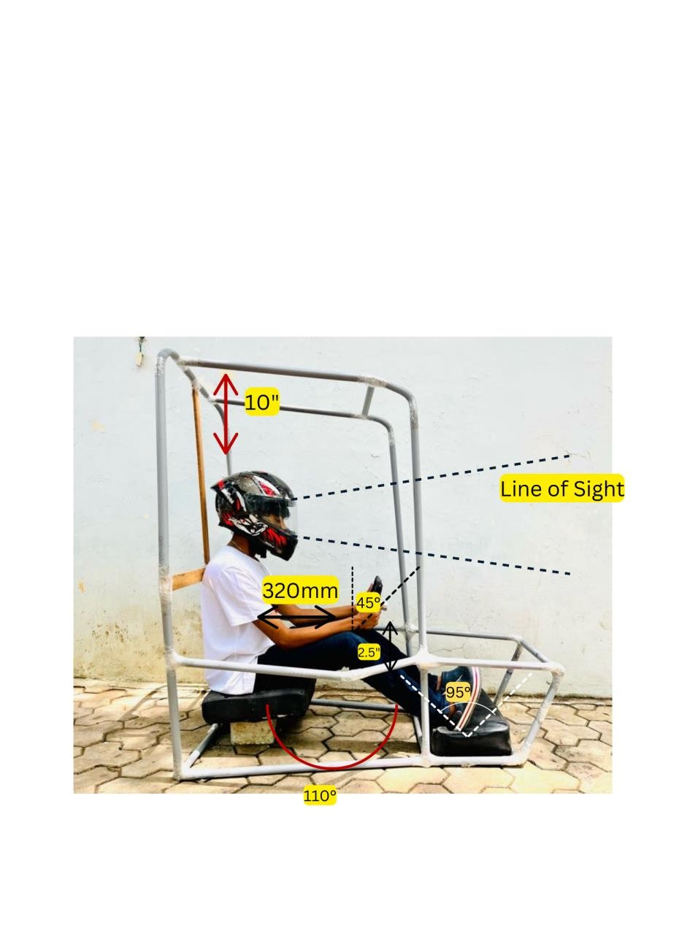
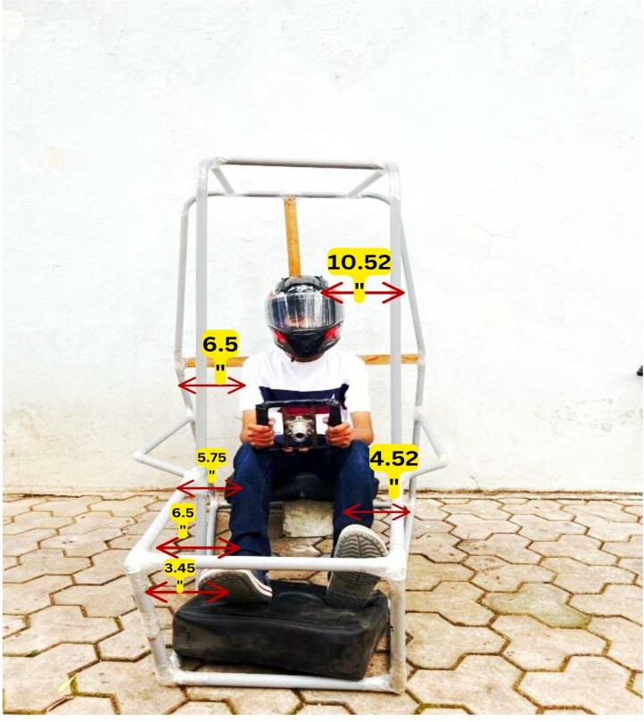
Roll Cage Design Process-Ergonomics
4
Accepting clearances of Rulebook with driver’s comfortable positions
Considering the previous team’s design and failures to fix optimum length
Constructing PVC Mock-
Up to verify clearances
Drafting CAD model and its verification
Analysis and
Optimization
Design Validation
PVC Mock-Up was made to check the clearances between driver and roll cage with mentioned values in the rulebook, while the driver is in comfortable postures and all the controls are within the reach of driver.
CONSIDERATIONS:
Driver oriented Roll Cage design
All the rule book conditions are satisfied
Polar moment of inertia is maximized
FBM are adjusted wider for Ensuring Good Visibility
Roll cage is made for better turning radius and vehicle aesthetics
Easy for egress test and driver can escape easily in case of any dangers
All controls are within the reach of the
driver comfortably
Providing Necessary Reinforcements
After safety, weight is decreased by using primary & secondary members
Material is kept farther from rotating axis to
increase Torsional rigidity
Strength to weight ratio is to be improved

Slide 5
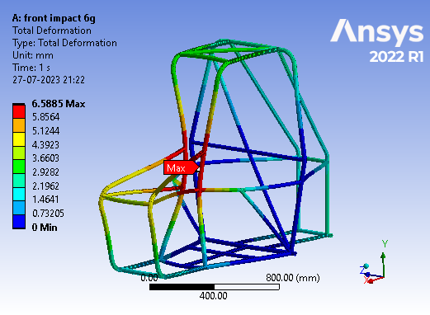
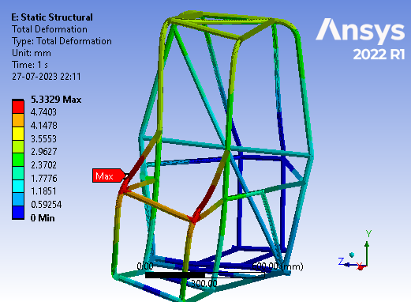
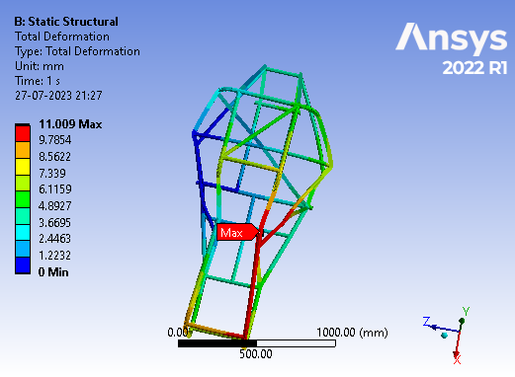
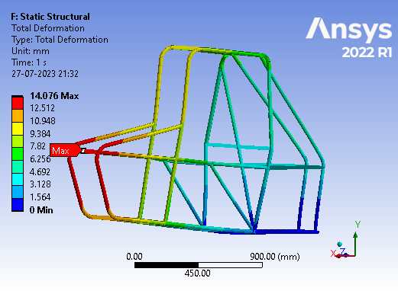
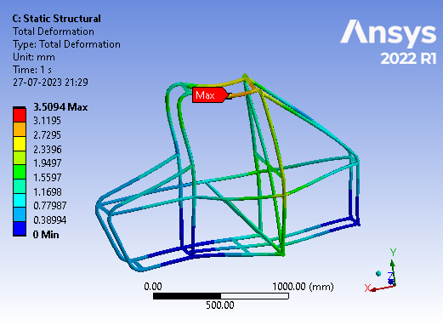
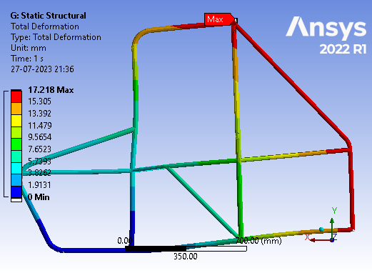
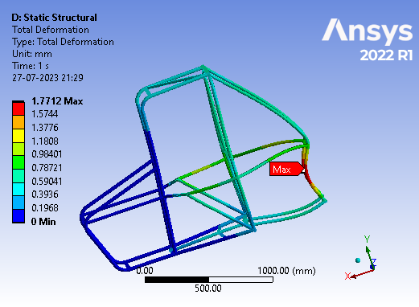
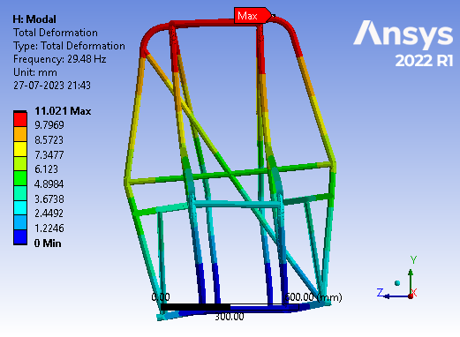
Force | 6G
Stress | 422.8 Mpa
Deformation | 6.5885mm
F.O.S | 1.08
Force | 2G
Stress | 177.1Mpa
Deformation | 5.3329mm
F.O.S | 2.59
Property | AISI 4130 | AISI 1018 | AISI 1020
Ultimate T.S (Mpa) | 560 | 440 | 395
Yeild S.T (Mpa) | 460 | 370 | 295
Carbon content (%) | 0.28-0.33 | 0.14-0.20 | 0.17-0.23
Elongation (%) | 21.50 | 15.00 | 36.50
Front impact test
Torsional test
Force | 3G
Stress | 387.9Mpa
Deformation | 11.009mm
F.O.S | 1.18
Force | 1G
Stress | 331.3Mpa
Deformation | 14.076mm
F.O.S | 1.38
Pipe | primary | secondary
External diameter | 29.2mm | 25.4mm
Thickness | 1.65mm | 2mm
welding | TIG welding
Side impact test
Front bump test
Force | 3G
Stress | 199.9Mpa
Deformation | 3.5094mm
F.O.S | 2.30
Force | 1G
Stress | 307.4Mpa
Deformation | 17.218mm
F.O.S | 1.49
CAE process
Element Size: An element of size nearest to smallest dimension is considered (2mm) to reduce percentage error. 1D analysis is performed to reduce computational time and to get good results with least complications. Modal analysis is done to understand the effect of vibrations from the engine on the roll cage.
Roll over test
Rear bump test
Force | 4G
Stress | 154 Mpa
Deformation | 1.7712mm
F.O.S | 2.98
Frequency 1 | 29.48Hz
Frequency 2 | 51.59Hz
Frequency 3 | 54.26Hz
Frequency 4 | 68.60Hz
deformation | 11.02mm
rear impact test
Modal analysis

Slide 6
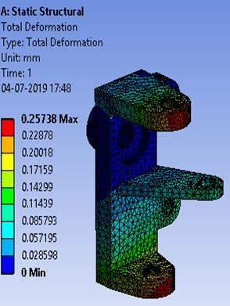
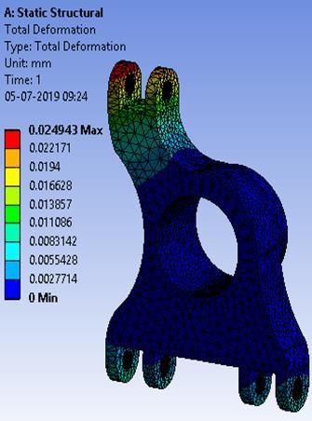
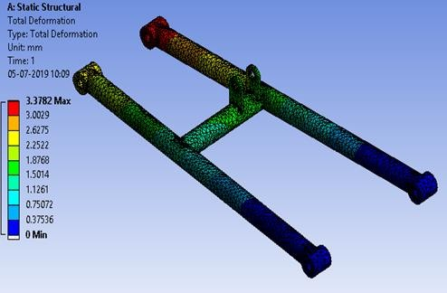
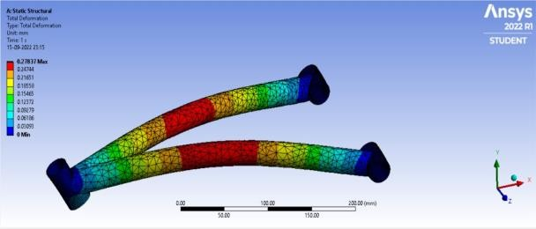
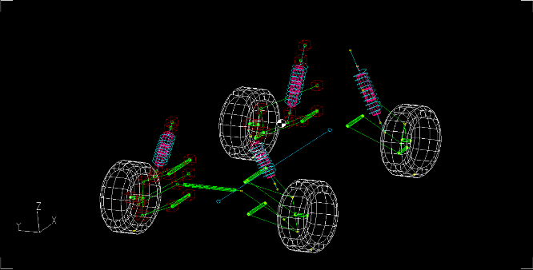
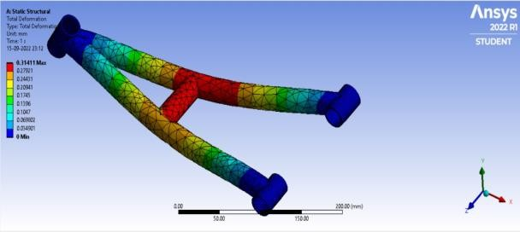
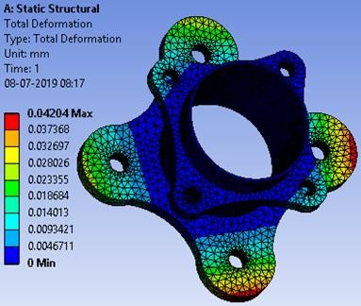
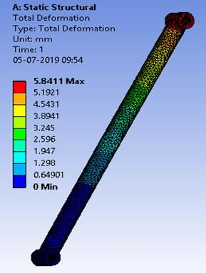
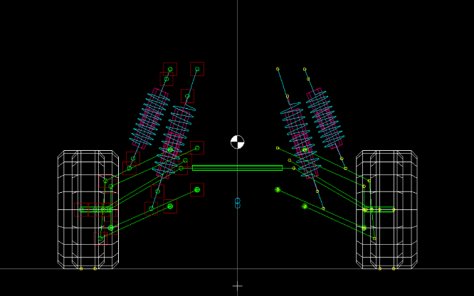
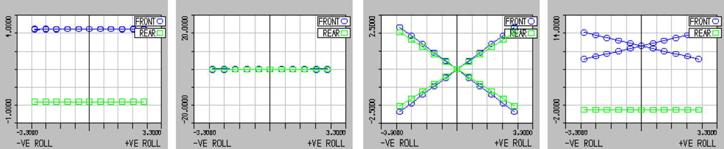
Suspension
6
Front | Double Wishbone
Rear | H arm with an upper link
CG Height | 19 inch
Ground Clearance | 14 inch
Sprung mass | 110kg
Un-sprung mass | 50kg
Parameter | Front | Rear
Roll Centre (mm) | 259.11 | 181.45
Motion Ratio | 0.473 | 0.8
Camber | 0 | 0
Caster | 4.41 | 0
KPI | 5.1 | 0
Scrub (mm) | 28.27 | 0
Toe | 0 | 0
Design | Front | Rear
Desired Natural Frequency (Hz) | 1.75 | 2.4
Ride Rate (N/mm) | 11.77 | 17.89
Spring Rate (N/mm) | 9.1 | 25.9
Wheel Rate(N/mm) | 2.03 | 16.57
Factor of safety | 1.73 | 1.73
Suspension Travel (inch) | 5.9+ 1.61 | 5.9+1.48
Damper Stroke (inch) | 6.2 | 4.5
Damping Value at 0.3m/s (N) | 1417.77 | 1791

Slide 7
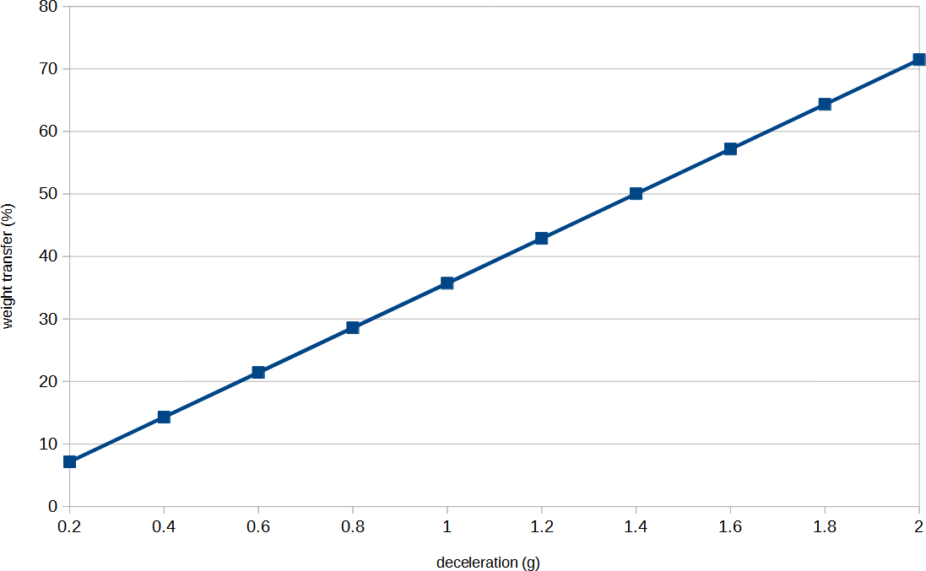
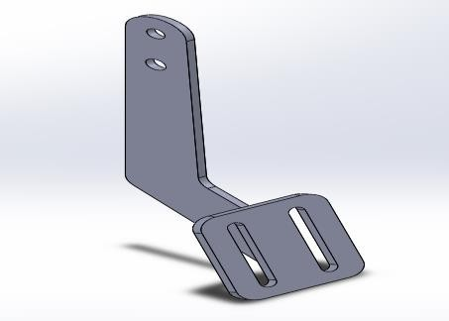
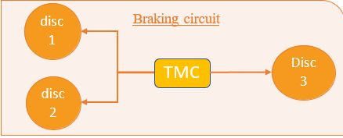
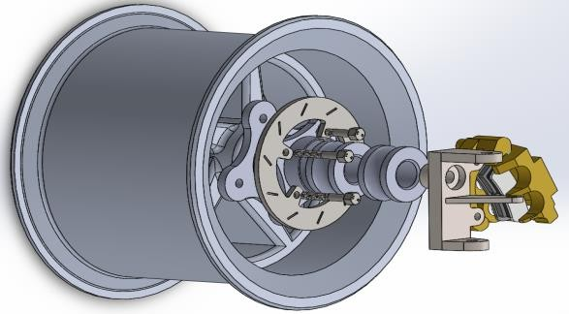
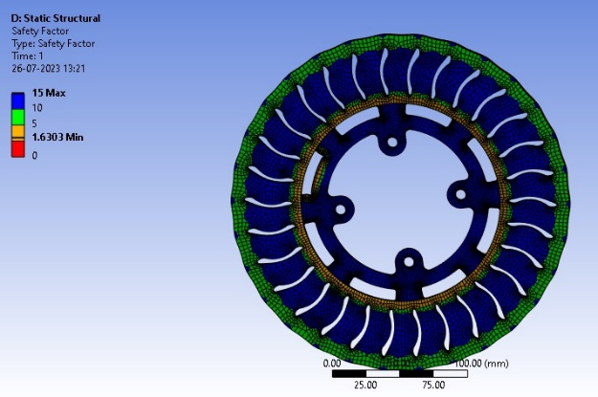
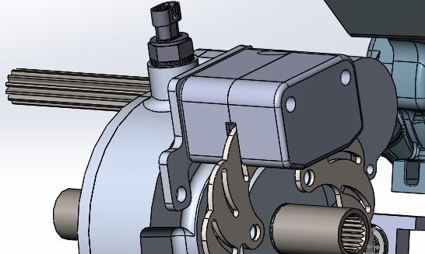
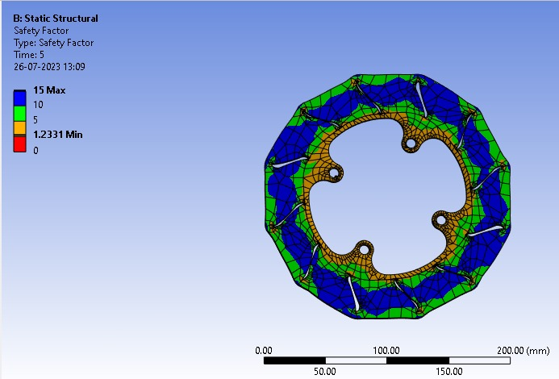
Braking
Braking calculations
7
Braking circuit
Weight transfer % Vs Deceleration (g)
split | Front-rear split
Master cylinder | Bore size*stroke 19.05mm*25mm
Caliper cylinder | bore : 1” 2 pot caliper
Brake disc | Front OD : 180mm Rear OD : 220mm Thickness : 3mm
Brake caliper pad | Mean braking radius : 83.5mm(front),102.5 mm(rear) Area : 506.7mm²(front) 839.81mm²(rear) Coefficient of friction: 0.4
Brake fluid | DOT 4
Field | Result
Weight transfer at 40 Kmph to 0 Kmph | 228.98 N (15.76% of weight is transferred from the rear)
Static rolling radius | 292.1mm
Considered coefficient of friction for road | 0.7
Brake torque required per wheel | Front : 315.464Nm Rear : 185.996Nm
Braking force | Front : 2844.44N Rear : 2357.11N
Brake pedal design
Expected performance
Field | Result
Pedal force | 200 N
Stopping distance | 2.96 m/s
Pedal travel | 125 mm
disc 1
Wheel assembly (front)
Advantages of inboard braking system
Reduction in sprung mass and larger discs can be accommodated
Reduction of force on suspension arms
Less complex design of hub and easier brake line routing
CAD model of inboard brakes (Rear)

Slide 8
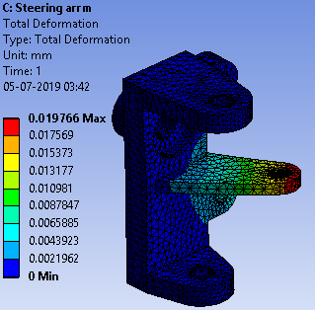
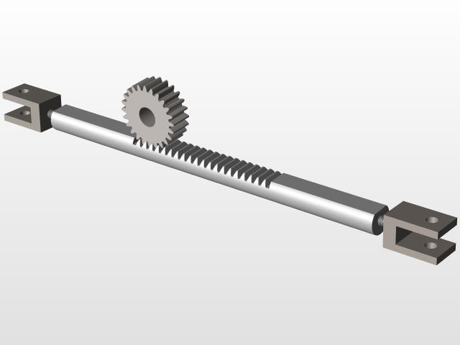
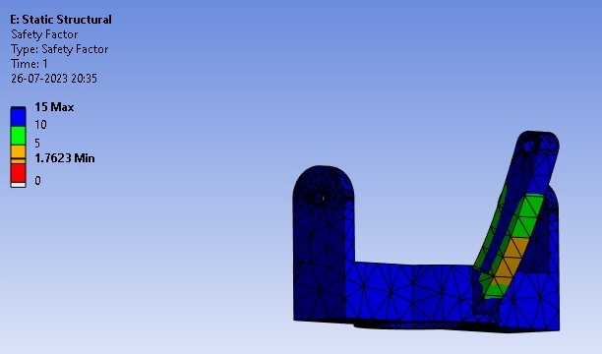
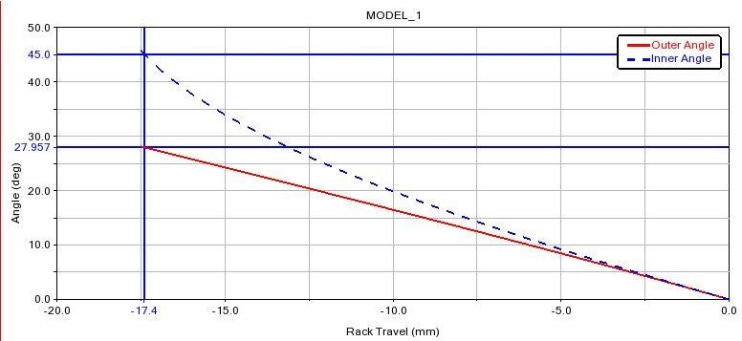
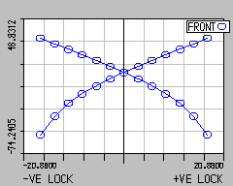
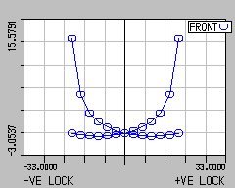
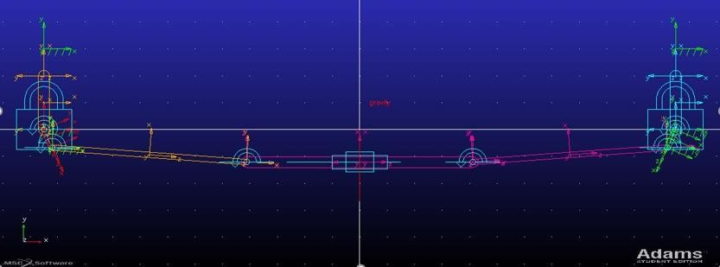
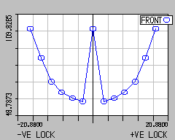
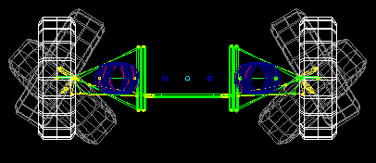
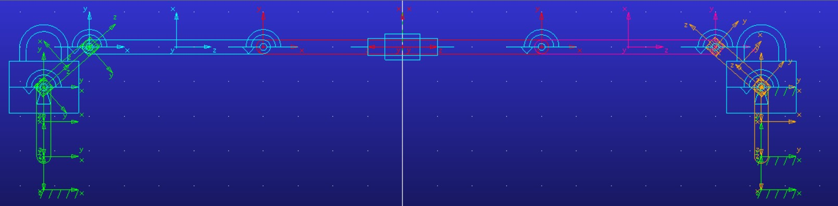
Steering
Rack and Pinion - CAD model
8
Steering Gear: Rack & Pinion
Steering Arm
Steering Column
Type of Drive | Centre
Rack Travel (centre to end) | 17.4mm
Lock to Lock | 0.94 rev
Steering Ratio | 37 mm/rev
Length of Tie rod | 260.629mm
IBJ centre distance | 205.74mm
OBJ centre distance | 560.825 mm
Min. turning radius | 1.4m
Type | Tilt
Assist | Powerless
Steering Wheel
Diameter | 240mm
Torque | 5.88Nm
Steering System: Ackerman
Rack Travel V/S Inner And Outer Angles
Steer V/s Toe angle
Steer V/s Camber angle
Steer Type | Understeer
Ackerman % | 99.98
Steering angle inside | 45˚
Steering angle outside | 27.957˚
Layout in ADAMS
Lotus Ackerman Percentage Chart
Lotus Analyzer

Slide 9
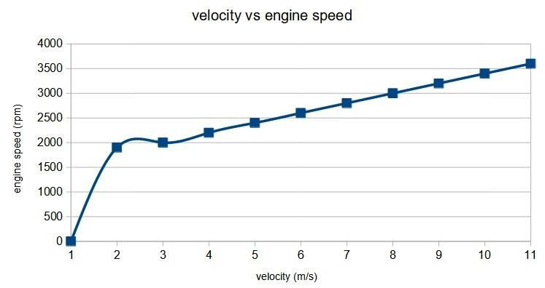
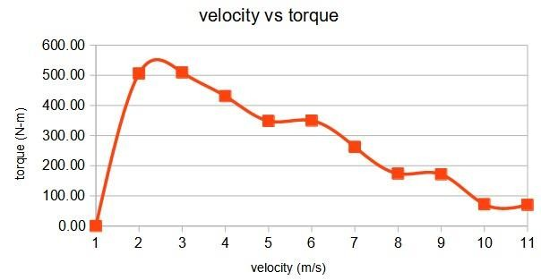
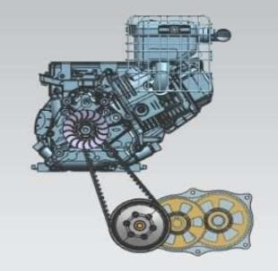
Power Train
9
Engine specifications
Vehicle performance
Vehicle performance
Displacement | 305cc
Bore x Stroke (in.) | 3.12” x 2.44”
Compression ratio | 8.1:1
Max power | 9.1hp @3600rpm
Max torque | 18.96N-m @2600rpm
max acc | 2 6.61 m/s
gradeability | 65.00%
top speed | 15.9 m/s
max torque | 524.21 N-m
Engine speed (rpm) | Enine torque (N-m) | Final gear ratio | Velocit y (m/s) | Acceleration (m/s2) | Wheel torque (N-m)
1900 | 18.3 | 36 | 1.20 | 6.35 | 505.96
2600 | 18.96 | 36 | 1.65 | 6.61 | 524.21
3000 | 18.86 | 24 | 2.85 | 4.10 | 347.60
3200 | 18.59 | 24 | 3.04 | 4.02 | 342.59
3600 | 17.66 | 5.16 | 15.90 | 0.13 | 70.00
Tyre size | 23x7x10 (in)
Transmission unit
Gear box specifications
Cc distance | 216mm
Min ratio | 3:1
Max ratio | 0.43:1
Pitch length | 860mm
Rear | Two stage reduction Gear ratio 12:1
Front | Open differential with gear ratio 12.76:1
Rear: UV axles
Front: CV axles->Inboard: Tripod
Outboard: Rzeppa
Cv
shaft
NVH Considerations
Triangulation paths are made in the frame to reduce
the vibrations & have a better travel path across roll cage
Suspension Mounts are made triangular & designed to reduce harshness of vehicle
the engine is mounted on a spheroidal cast iron plate due to its ability to absorb vibrations
Open
Differential
Propeller shaft
Engine
Reduction Gearbox
Uv
shaft
CVT
Power train layout

Slide 10
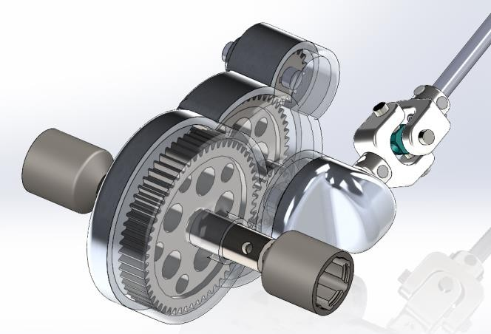
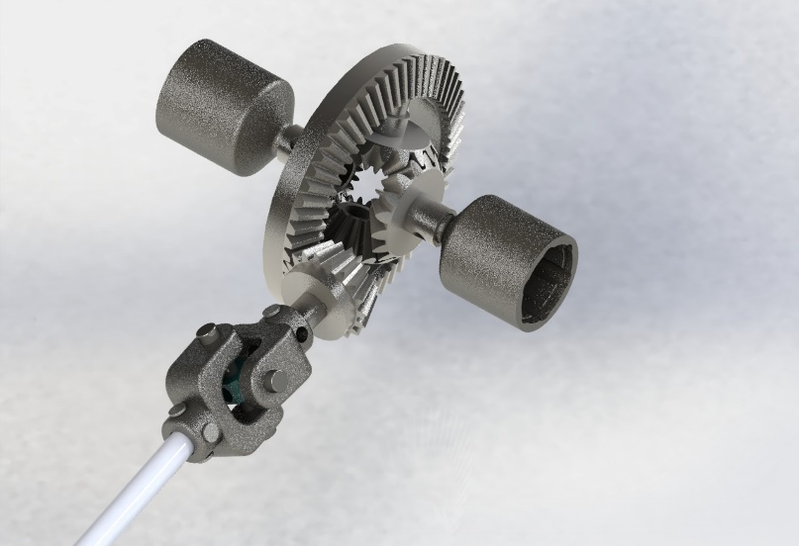
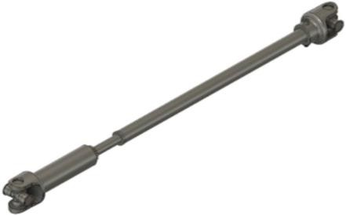
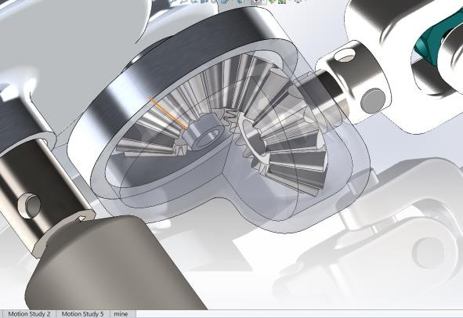
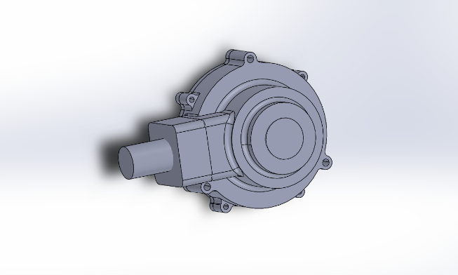
4WD/AWD
9a
Open Differential
An open differential in the front gives us the required torque multiplication and gear ratio
Differentials give independence to the wheels which is better for overall force flow in the front axles
Rear 4WD Gearbox
Gearboxes
EN 353 material is used in manufacturing of the gears due to its hardness, toughness and wear resistance
Al6061 is used as its casing material due
to its Strength to Weight Ratio
The gearboxes are designed based of Lewis-Buckingham Equations
Open Differential
Mounting and Installation
Supporting members are given as mounting w.r.t RRH & Rear Lower Cabin
Engine/CVT/Gearboxes is installed with help of the Dampers, Splines & Fasteners
Propeller Shaft
Propeller shaft
A one piece propellor shaft is used with two universal couplings at the ends
The propeller shaft is made with an aluminum steel alloy
Rear gearbox (propellor shaft output)
Open Differential CAD File

Slide 11
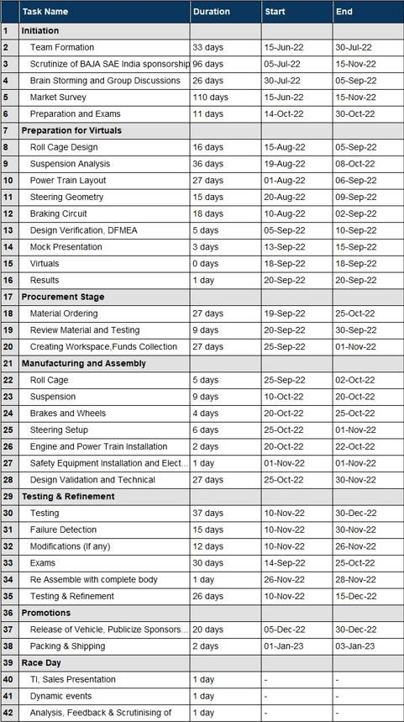

Project plan
10

Slide 12
11
Design Failure Mode And Effective Analysis
PART | Failure Mode | Potential Effect(s) of Failures | S | Potential Cause(s) | O | Current Design Control | D | RPN | O | D | RPN
Frame | Structural Failure | Driver’s safety is endangered | 10 | Excess load/Impact load | 6 | Chosen material with high F.O.S | 6 | 360 | 2 | 3 | 60
Bracket | Fracture | Structural damage to cage | 9 | Constant vibration | 5 | Reduced vibrations | 7 | 315 | 1 | 2 | 18
Support | Bending & Breakage | Dislocation of components | 10 | Axial stress > Yield stress | 5 | Effective design and analysis is done | 6 | 300 | 2 | 2 | 40
Engine | Parts damage | Improper combustion | 9 | Air Filter blocks | 5 | Positioning where free access of air | 4 | 180 | 4 | 1 | 36
Leakage of fuel | Hose Pipe Fractures | Poor engine performance and engine economy | 9 | High Temp/Sharp Bends/External force | 3 | Mounting and lengths are properly taken and fitted with min. turns | 3 | 81 | 1 | 1 | 9
Shaft | Mechanical | Vehicle is inoperable | 8 | Damage due to Cyclic loadings | 2 | Designed Acc. to load and performance | 4 | 64 | 1 | 2 | 16
Springs | Surging/Buckling | Damage to system or comfort | 6 | Excess loading | 2 | Proper designing of spring with ACF | 3 | 36 | 1 | 3 | 12
A arms | Bend/Break | Damage to system | 6 | Axial Stress > Yield Stress | 7 | Effective design and analysis is done | 7 | 343 | 3 | 3 | 54
Damper | Leakage of oil | Damage to suspension | 6 | Mechanical Fail | 2 | Verification of specification & testing | 2 | 24 | 1 | 1 | 6
Knuckles or Uprights | Structural Failure | Moving of Vehicle becomes harder | 8 | Double Shear & Crushing | 6 | Design according to vehicle specifications & High F.O.S | 8 | 384 | 2 | 3 | 48
Steer Wheel | Breakage | Direction of Vehicle is hard | 9 | Excess Load | 9 | Proper specification of wheel | 2 | 36 | 1 | 1 | 9
Rack & Pinion | Backlash/Play | Steering System Fails | 9 | Movement of UV joints | 6 | Correct Mountings & Installations | 7 | 378 | 2 | 3 | 54
Steering arm | Bend/Break | Steering Geometry Fails | 8 | Excess Load | 6 | Effective Design & Analysis | 8 | 384 | 2 | 3 | 42
Braking system | Wheels not locking | Vehicle fails to stop | 9 | Improper Brake Force, Bleeding | 6 | Proper bleeding is done, effective Design Of Pedal Ratio &Travel | 3 | 162 | 2 | 2 | 36
Pedals | Brake Failure | Brake failure | 9 | Excess Load | 2 | Material with high F.O.S | 1 | 18 | 1 | 1 | 9
Tyre | Deformation/Burstin g | Inability to operate vehicle | 7 | Punctures/ Excess Pressure | 8 | Proper suitable terrain tyres, correct psi is maintained Acc to specification | 2 | 112 | 3 | 1 | 21
Electricals | Improper Functioning | Endangers Driver’s Safety/ Components Mis-Function | 9 | Water Damage/ Short Circuit | 6 | Proper insulation should be provided & wiring should be properly done | 2 | 108 | 2 | 1 | 18

Slide 13
12
Design Validation Plan
Vehicle Part | Performance Target | Acceptance Criteria | Validation Method
Steering Geometry | Turning radius of 1.5m | Comfortable to ride in eight track | Calculated and simulated using Adams and Lotus software
Steering system | Deviation is < 0.05m when vehicle is run on a straight line | Deviation should be < 0.1m | Simulations in Adams and Lotus software
Transmission | Top speed 56kmph | Greater than 45kmph | Tachometer
Oils | There should be no leakage of oil when vehicle is rolled over | No oil spills on any surface when vehicle is tilted | Observed manually by tilting on a dry surface
Egression Test | 3 seconds | Less than 5 seconds | Stop watch
Braking Distance | Braking distance 3.04m | Braking distance should be less than 8m | Measuring distance using tape
Braking | All four wheels locking at the same time when brakes are applied | All wheels should lock simultaneously without rolling motion | Measured at 40 kmph
Gradeability | Able to climb hill at 45° inclination | Enough torque should be generated to climb at 33 inclination | Uphill/inclined ramp
Suspension Check | No changes in any of the members/links when dropped at height of 2m | No displacement of components when dropped | Drop test and Physical verification
Ergonomics | Clearances to be checked using PVC mock up and considering comfort of driver | All clearances should be >3’’ ; helmet to RRH end points which is 6’’ | Measuring tape
Weld Ment | Point of welding area shouldn’t undergo any bend/crack. | Material should break at a point near the bend and not at weld | Destructive testing
H & A arms | No bending occurs when landed on single wheel | No deformations when heavy loads are applied | Proper design with optimum F.O.S
Mountings | No bending observed in sudden load | No deformation is observed at weld / clamp region | Triangulation and Ansys validation

Slide 14










Team Composition With Work Allocation and Workshop Facilities
13
Captain/Spokes
h
Harikrishna Ashfaq Tanish
Person/Overall Coordinator
Quality/Testing/Validation
Abhiram Saraschandra Vikas
Roll Cage designer/Fabrication
Rohan Aaron
Satvik
Varun
Lathes
Arc welding
Grinding
Suspension/Steering/ Braking/Controls
CAE/DFMEA/DVP
Harshini
Suheera
Mohnish
Satvik
Om
Abhilash Harsha
UTM
TIG Welding
Manufacturing Facilities Outside:
Drilling
Body/Electricals/
Safety Equipment
Vedika Swaroop Rohan Tadem
tadem
Power Train
Abhishek Meghana Vybhav
Marketing/Logistics
/Project Plan
Sathwik Arhaan Sukriti
CNC Pipe Bending CNC Milling Vehicle Testing
Purchasing, Cost
Akash Hemanth Jyothi

